Slide 1
Finding John Simpson, 1880-1900
The value of a information
found in county histories.

Slide 2
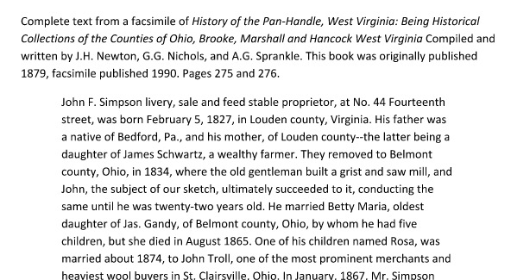
What we know: the county history provided a lot of information
SOURCE information
Trascnript vs. Abstract

Slide 3
From subsequent research
He is in Wheeling W. Virginia in 1880
Sarah E. Simpson, widow of John F. was listed in Toledo, Ohio by 1897.
A son married in Wheatland, North Dakota in December 1892.
Sarah Simpson was living in Toledo, Ohio in 1900, widowed.

Slide 4
Here’s an update…
found a homestead record for John F. Simpson dated 18 Aug., 1887..s “John F. Simpson of Kidder County, Dakota TerritorHis brother-in-law, Samual A. Hogue also applied to Homestead in the area in 1889.
John F. Simpson was also listed in the 1885 Dakota Territory census. I haven’t found any death records for him in that area but I’m getting closer.

Slide 5
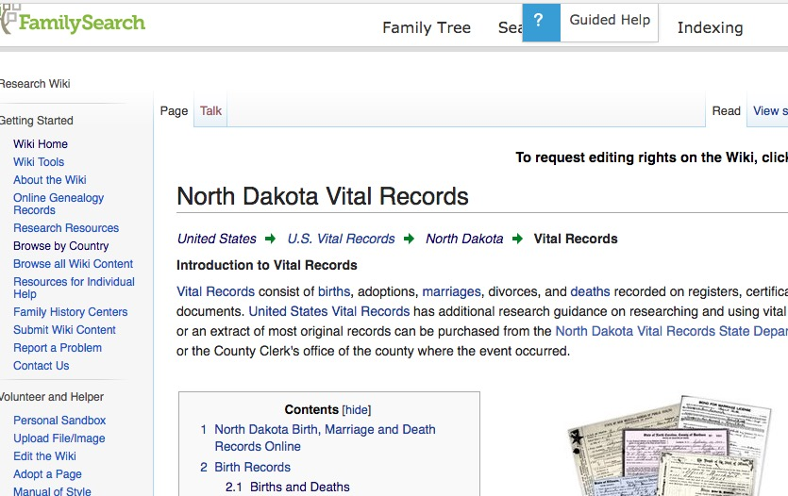
When did North Dakota start keeping death records?

Slide 6
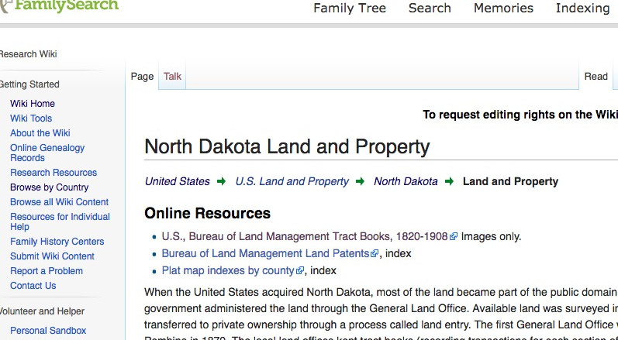
How do we find North Dakota Property Records

Slide 7
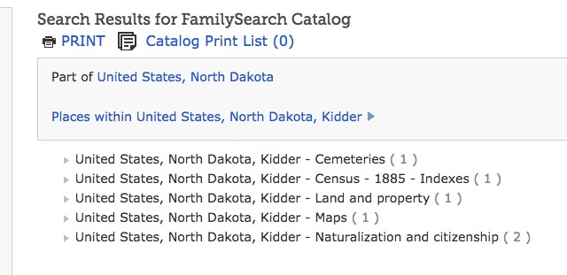
Did the FHL film
Kidder Co Probate Records?

Slide 8
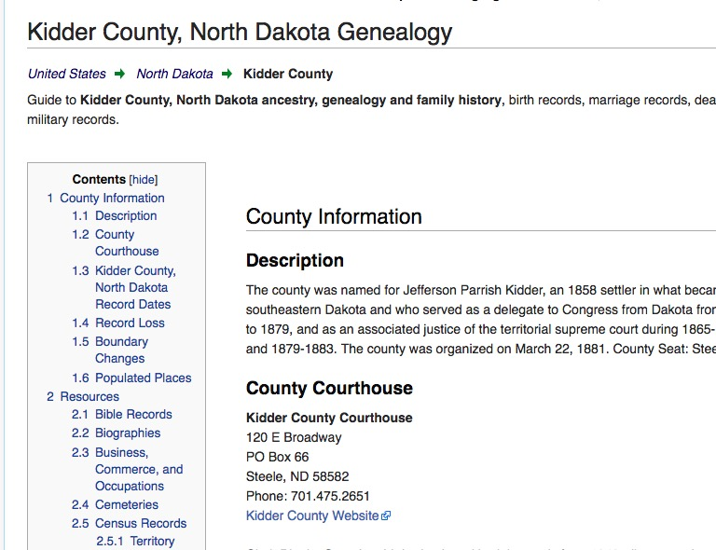
Don’t forget: There are county pages at the FamilySearch Wiki

Slide 9
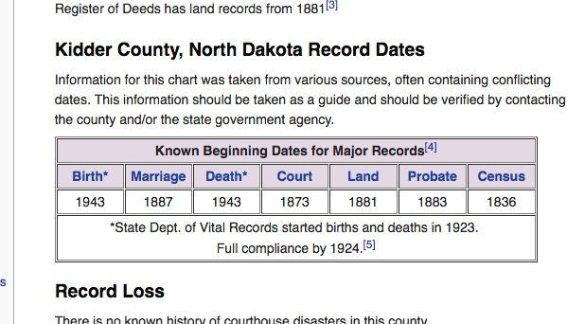
Handy chart on the Kidder Co. page

Slide 10
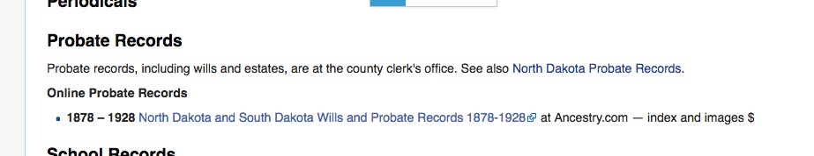
Kidder Co. page probate info

Slide 11
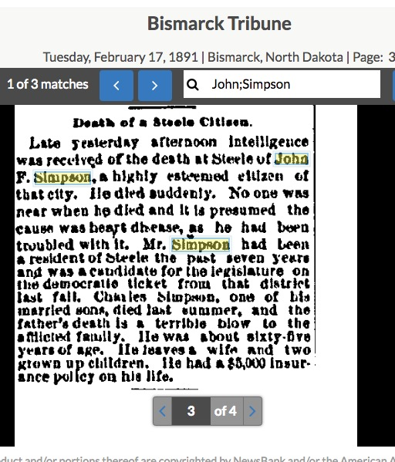
I cheated again
GenealogyBank

Slide 12

How do we find county histories?

Slide 13
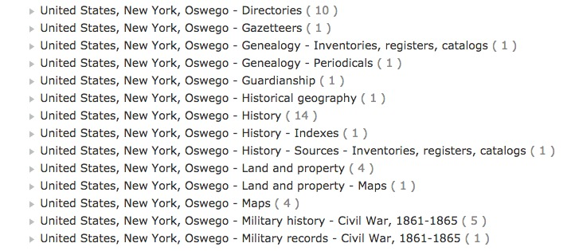
Check the FamilySearch.org catalog to find which ones exist

Slide 14
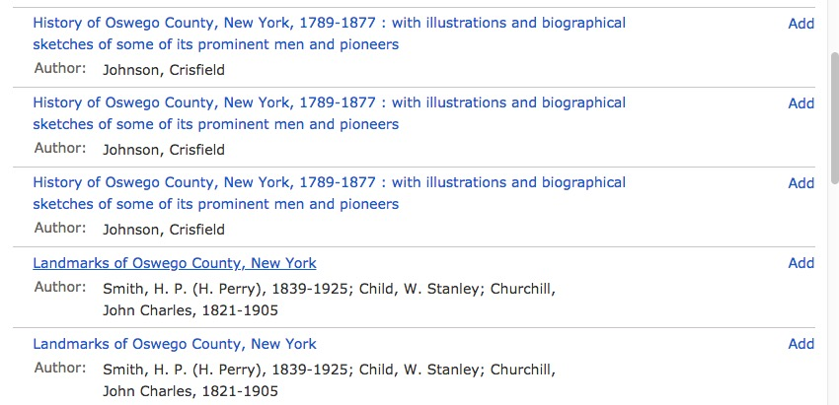
Many titles…sometimed more than one record for a title
More than one record for the same book usually means at least one is a digital copy.

Slide 15
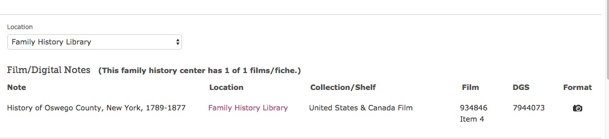
Click the camera to get to the images

Slide 16
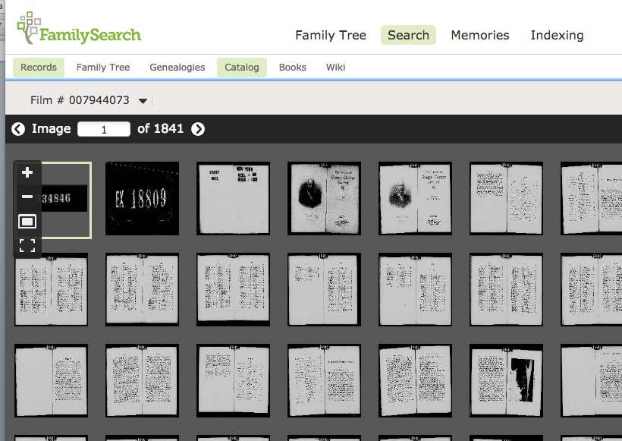
A camera brings up this kind of a digital copy

Slide 17
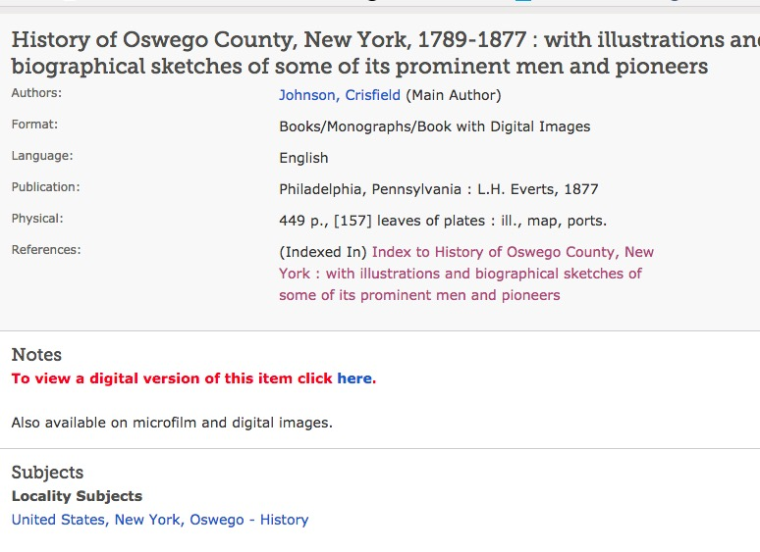
Sometimes instructions take you to a digital copy

Slide 18
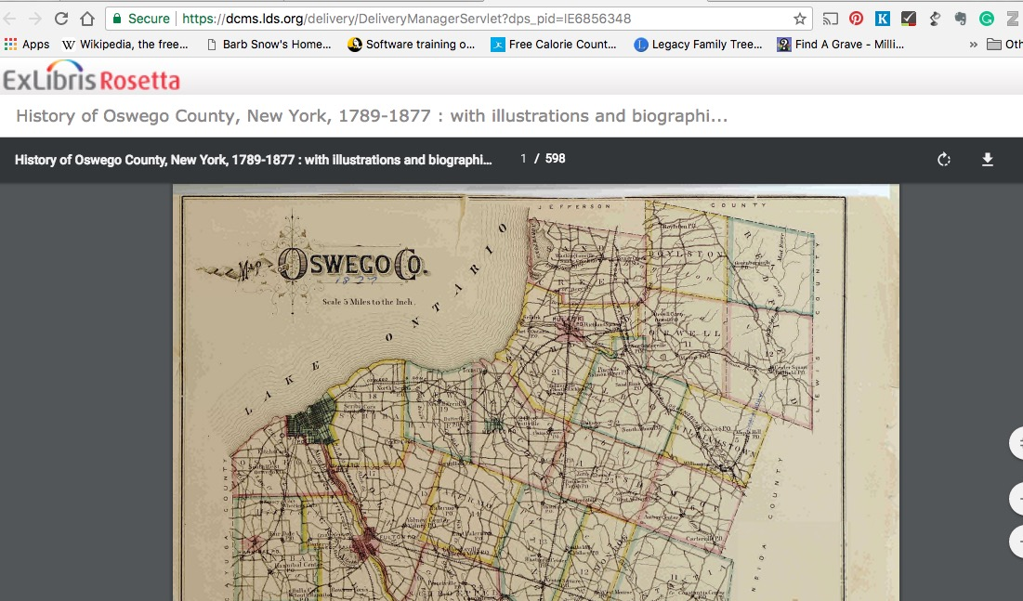
Instructions take you to a “book” copy

Slide 19
Google a title to find digital copies online
Internet Archive
Hathi Trust
Google Books
History of Cayuga County, New York, 1789-1879 : with illustrations and biographical sketches of some of its prominent men and pioneers
Author: Storke, Elliot G., 1811-1879; Smith, James H.

Slide 20
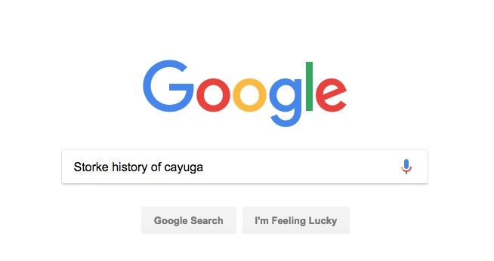
If a unique word, use that..

Slide 21
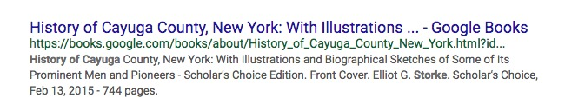
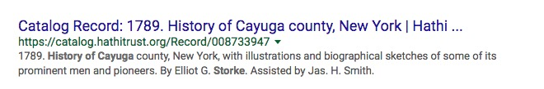
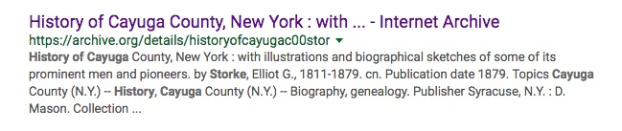
Google results

Slide 22
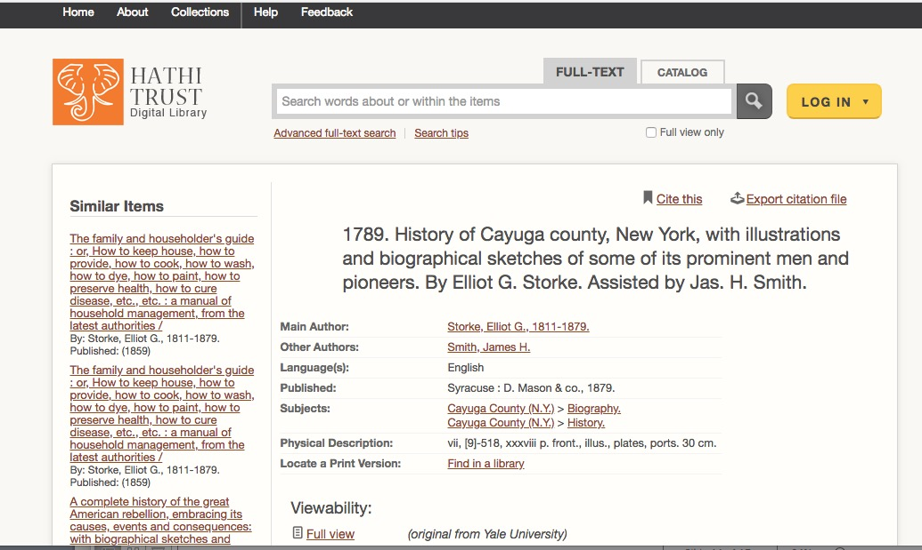
If you get to a Hathi Trust catalog record
Click here to get to volume

Slide 23
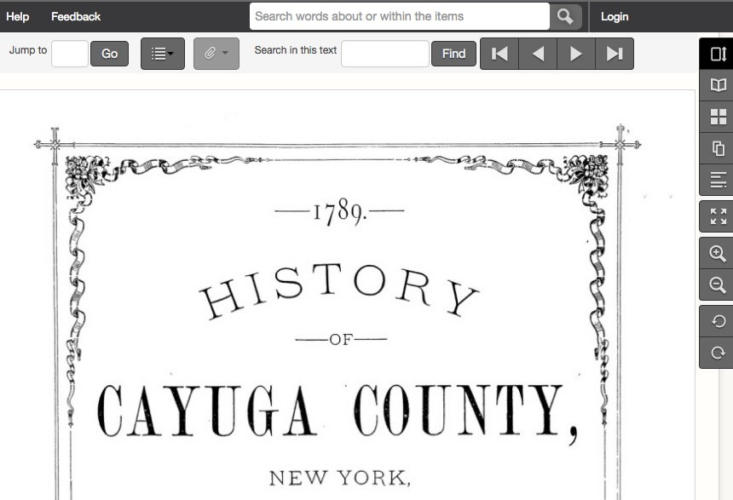
Hathi Trust copy.. Notice you can “search inside this text”

Slide 24
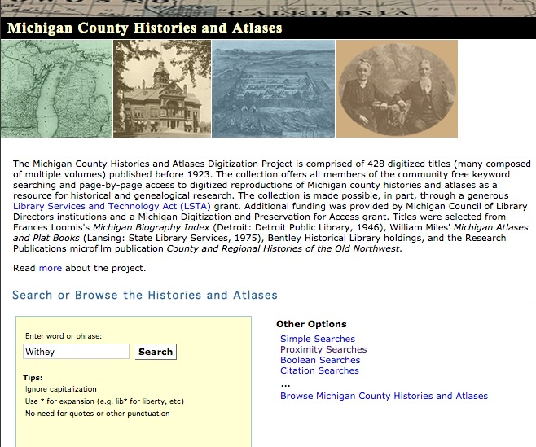
Michigan County Histories online https://quod.lib.umich.edu/m/micounty/

Slide 25
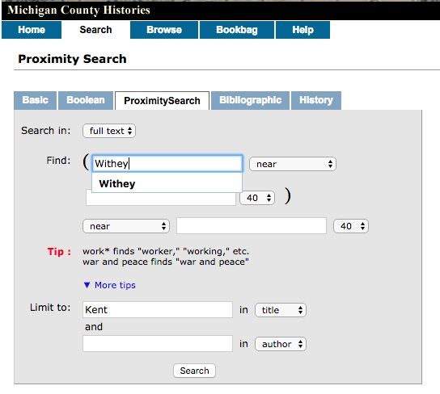
Proximity Search

Slide 26
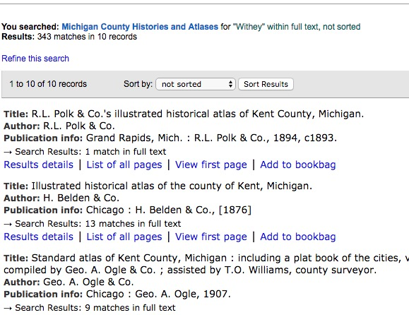
Results List

Slide 27
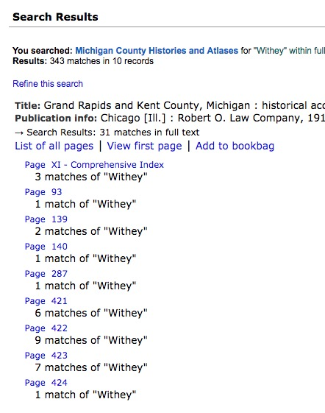
Result Details
Shows how many
hits on a page

Slide 28
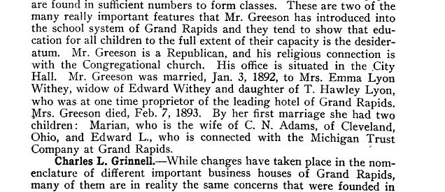
2 hits on page

Slide 29
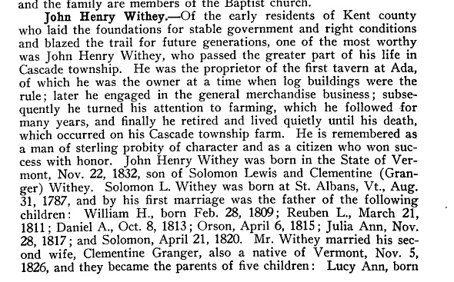
5 matches…6 on the next page,
9 on the next...

Slide 30
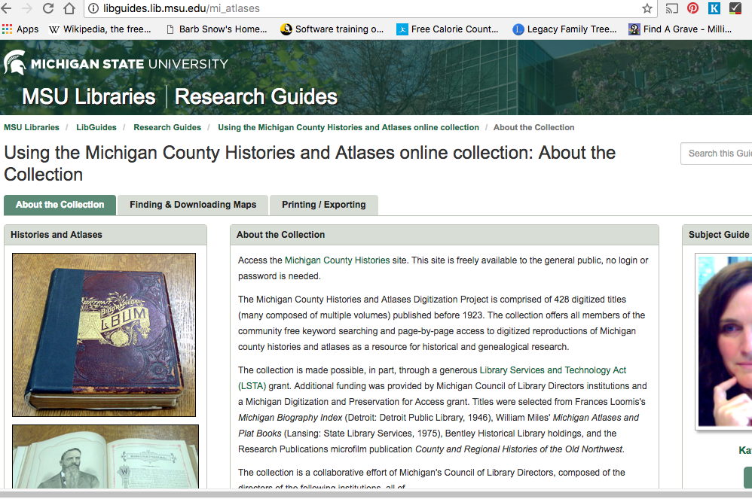
MSU created a “libguide” to this collections
Use the tabs

Slide 31
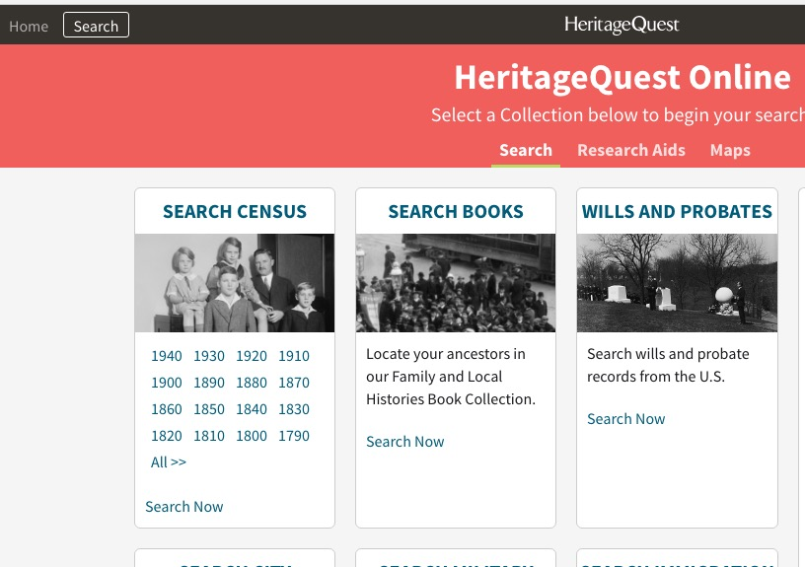
Many are on Heritage Quest

Slide 32
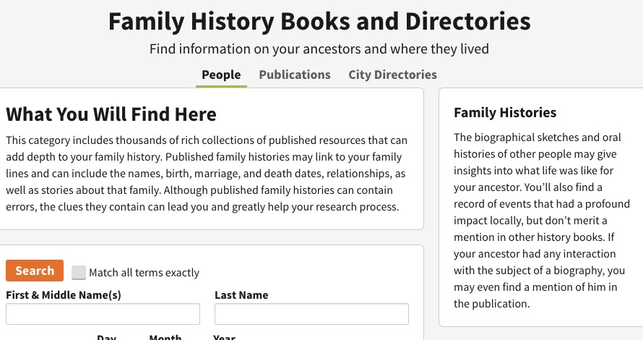
County Histories & City Directories
There is a Power Point Intro to Heritage Quest on my October 2017 page

Slide 33
A few stern warnings…
These books are full of errors.
These books are full of errors
These books are full of errors
But they also contain truth.
It’s your (fun) job to verify information by using
other records.

